Slide 1

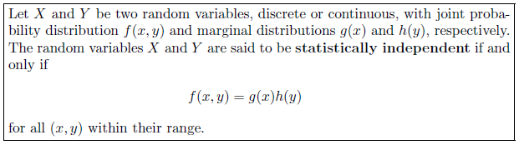

Slide 2


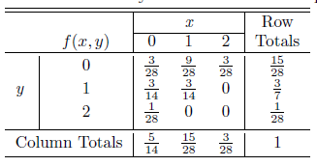
(b) Find the variables are not statistically independent.

Slide 3
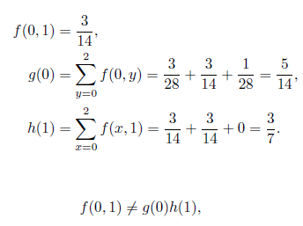
To find that the variables are statistically independent, we just have to prove that any of the relationship does not exist. Lets check the relationship at x=0 and y =1. So we know that

Slide 4
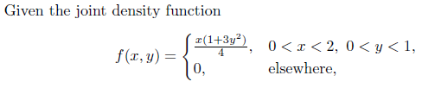
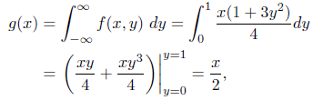
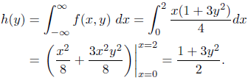

Now for the above function find g(x) and h(y) and find g(x)h(y). If f(x,y)=g(x)h(y) then x and y are statistically independent.

